Slide 1

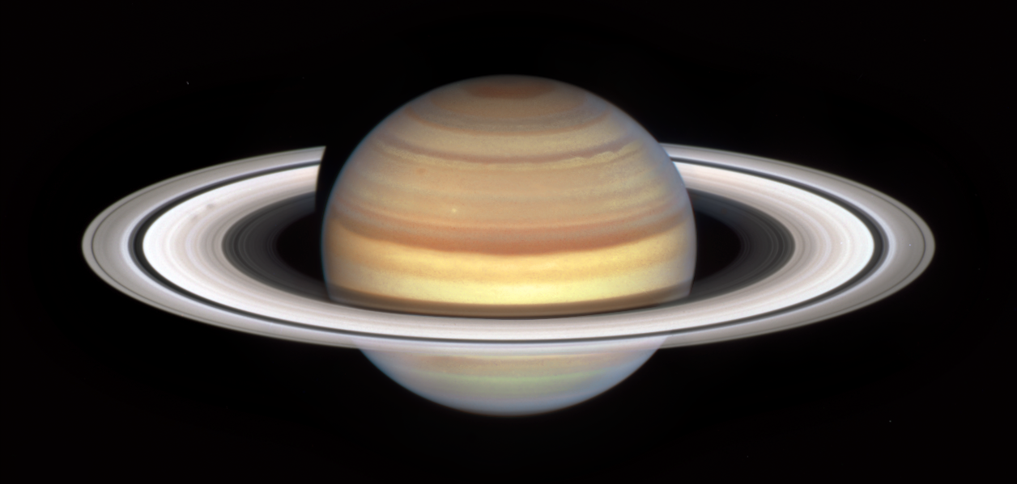
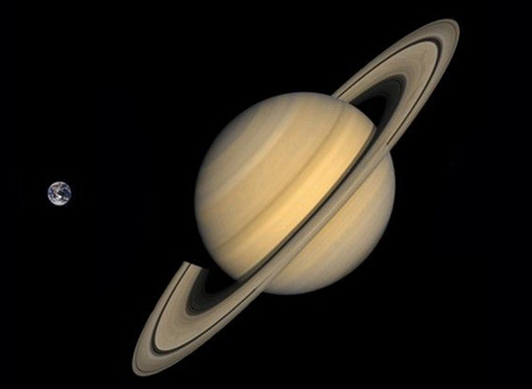
Ewell Astronomical Society – Nonsuch Park Planets Walk
8. Saturn
Jupiter
Uranuss
143 metres
323 metres
The ringed planet Saturn [Image: NASA]
Basic facts
Mean diameter - 116,000 kms (18 Earth diameters)
Mass – 95 Earth masses
Distance from the Sun – 1.4 billion km (10 times the Earth’s distance)
Year – 29 years
Day – 11 hours
Number of moons - 146
Saturn is the sixth planet from the Sun, and many would argue, the most beautiful. Saturn’s rings were first observed over 400 years ago soon after the invention of the telescope. Although the other giant planets also have ring systems, they are not easily seen and were all discovered within the last 50 years.
The Earth’s relative size
compared to Saturn [Image: NASA]
Saturn is primarily made of hydrogen and helium gas, and as such, does not have a surface. What we see through our telescopes are the clouds in Saturn’s atmosphere just in the same way as we have clouds here on Earth. However, Saturn’s clouds are whipped along by winds of up to 1,800 kilometres per hour! By comparsion winds in the most severe cyclones on Earth have been measured up to only 400 – 500 kilometres per hour.

Slide 2
Saturn’s rings are composed primarily of ice particles, along with rocky debris and dust, and stretch out for thousands of kilometres from Saturn but are very thin — less than a kilometre in thickness. It is their icy composition that allows then to easily reflect sunlight and making them so clearly visible from Earth. It is believed that Saturn's rings are likely to be remnants of comets, asteroids, or moons that ventured too close to the planet and were torn apart by its strong gravity.
Saturn currently over 145 known moons, of which, Titan is the largest. At over 5,000 kilometres in diameter Titan is larger than the planet Mercury and is only just beaten by Jupiter’s moon Ganymede to the title of the solar system’s largest moon. Titan is also the most distant object that man has landed a spacecraft on – the European Space Agency’s Huygens probe in 2005. Titan has a thick atmosphere mostly made of nitrogen, like the Earth. However, although Titan also has liquid on its surface, it is not liquid water, but liquid methane and ethane.

Slide 3
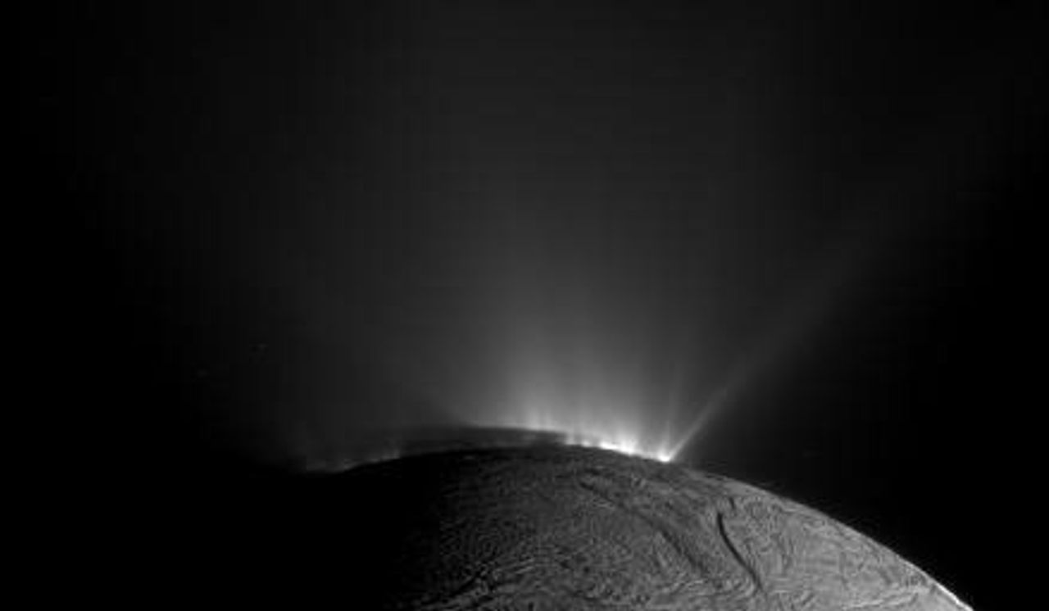

Another of Saturn’s interesting moon’s is Enceladus. Enceladus is very small, at just 500 kilometres in diameter. The visiting NASA Cassini spacecraft imaged what appears to be
Plumes of water escaping from Saturn’s moon Enceladus [Image: NASA]
plumes of water escaping from fissures on its icy surface leading to the theory that Enceladus harbours an ocean of liquid water below its frozen surface and so is one of the prime candidates for the search for life in the solar system.
Did you know?
Saturn is largely made of hydrogen and helium – the two lightest elements in the universe. As a result Saturn has about the same density as wood and so, if you had a bathtub big enough, it would actually float!

